Slide 1


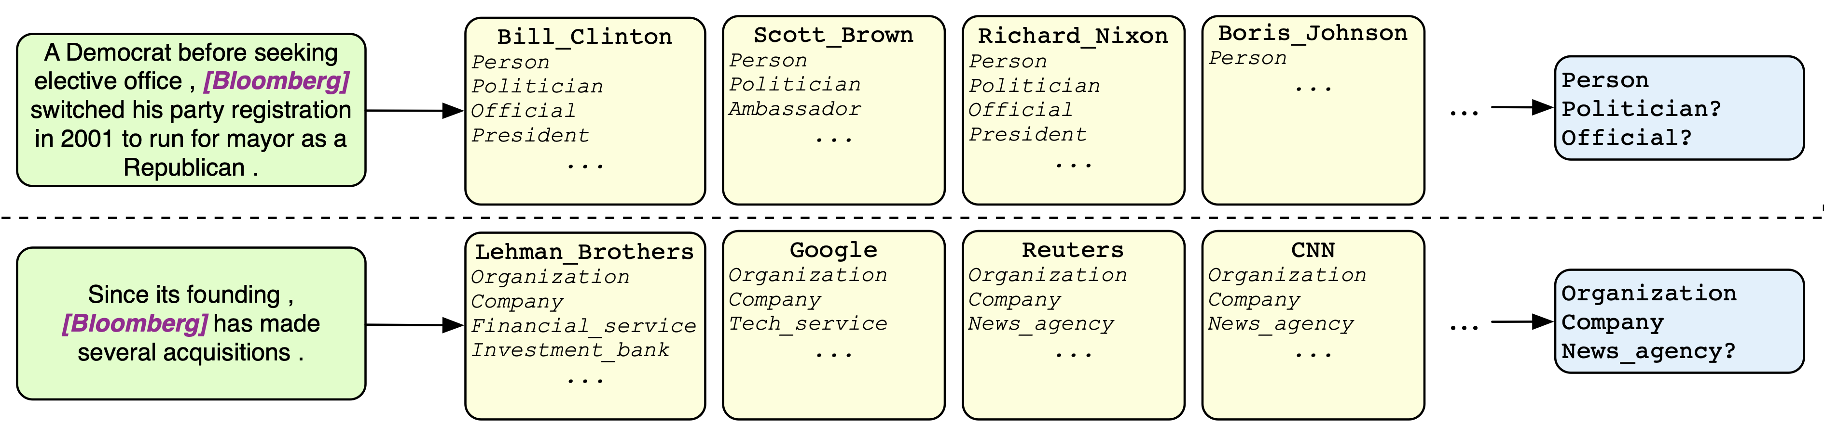
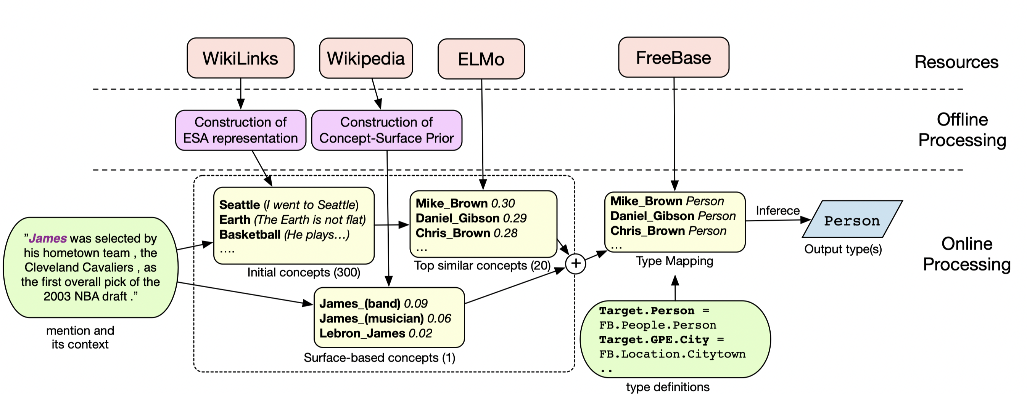
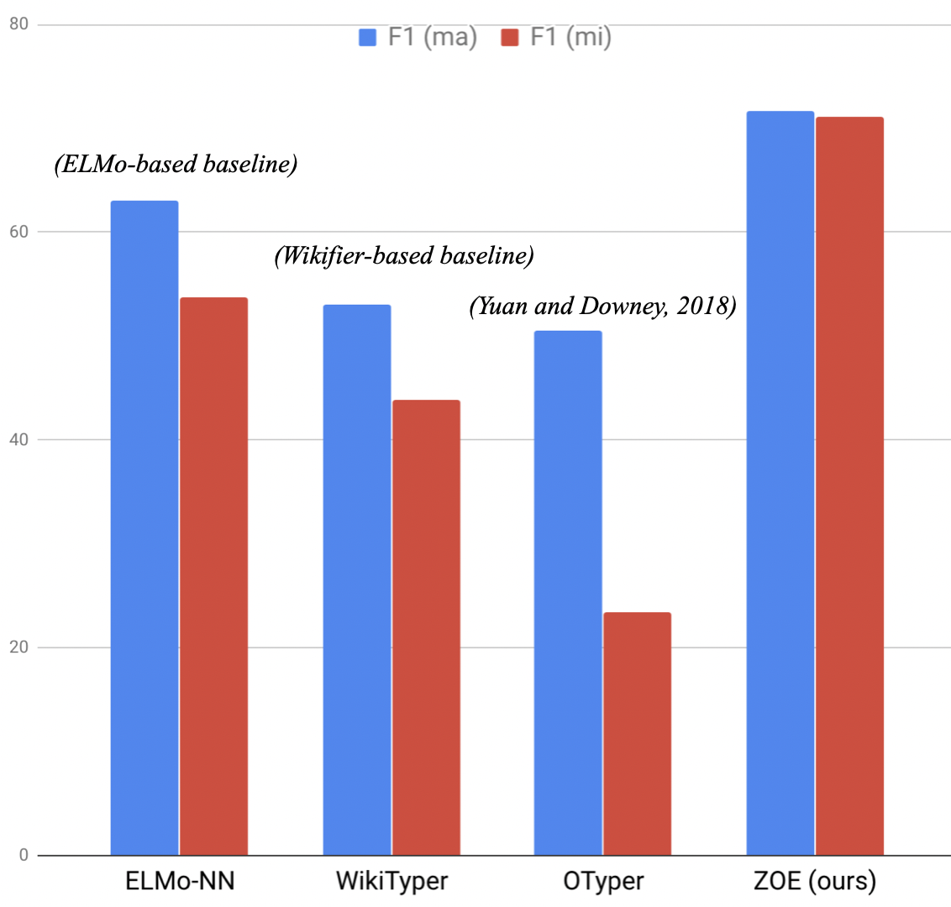
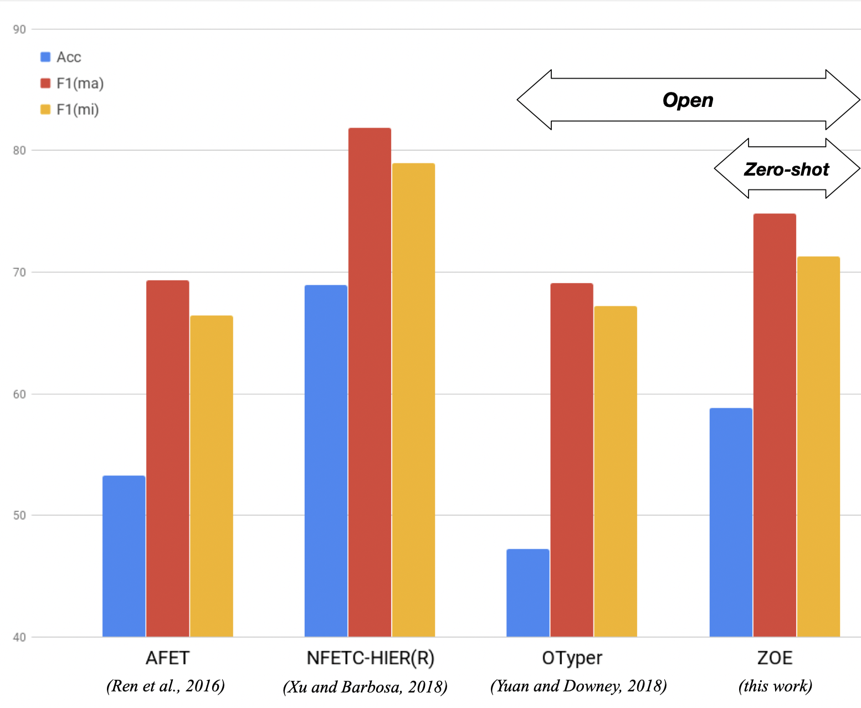
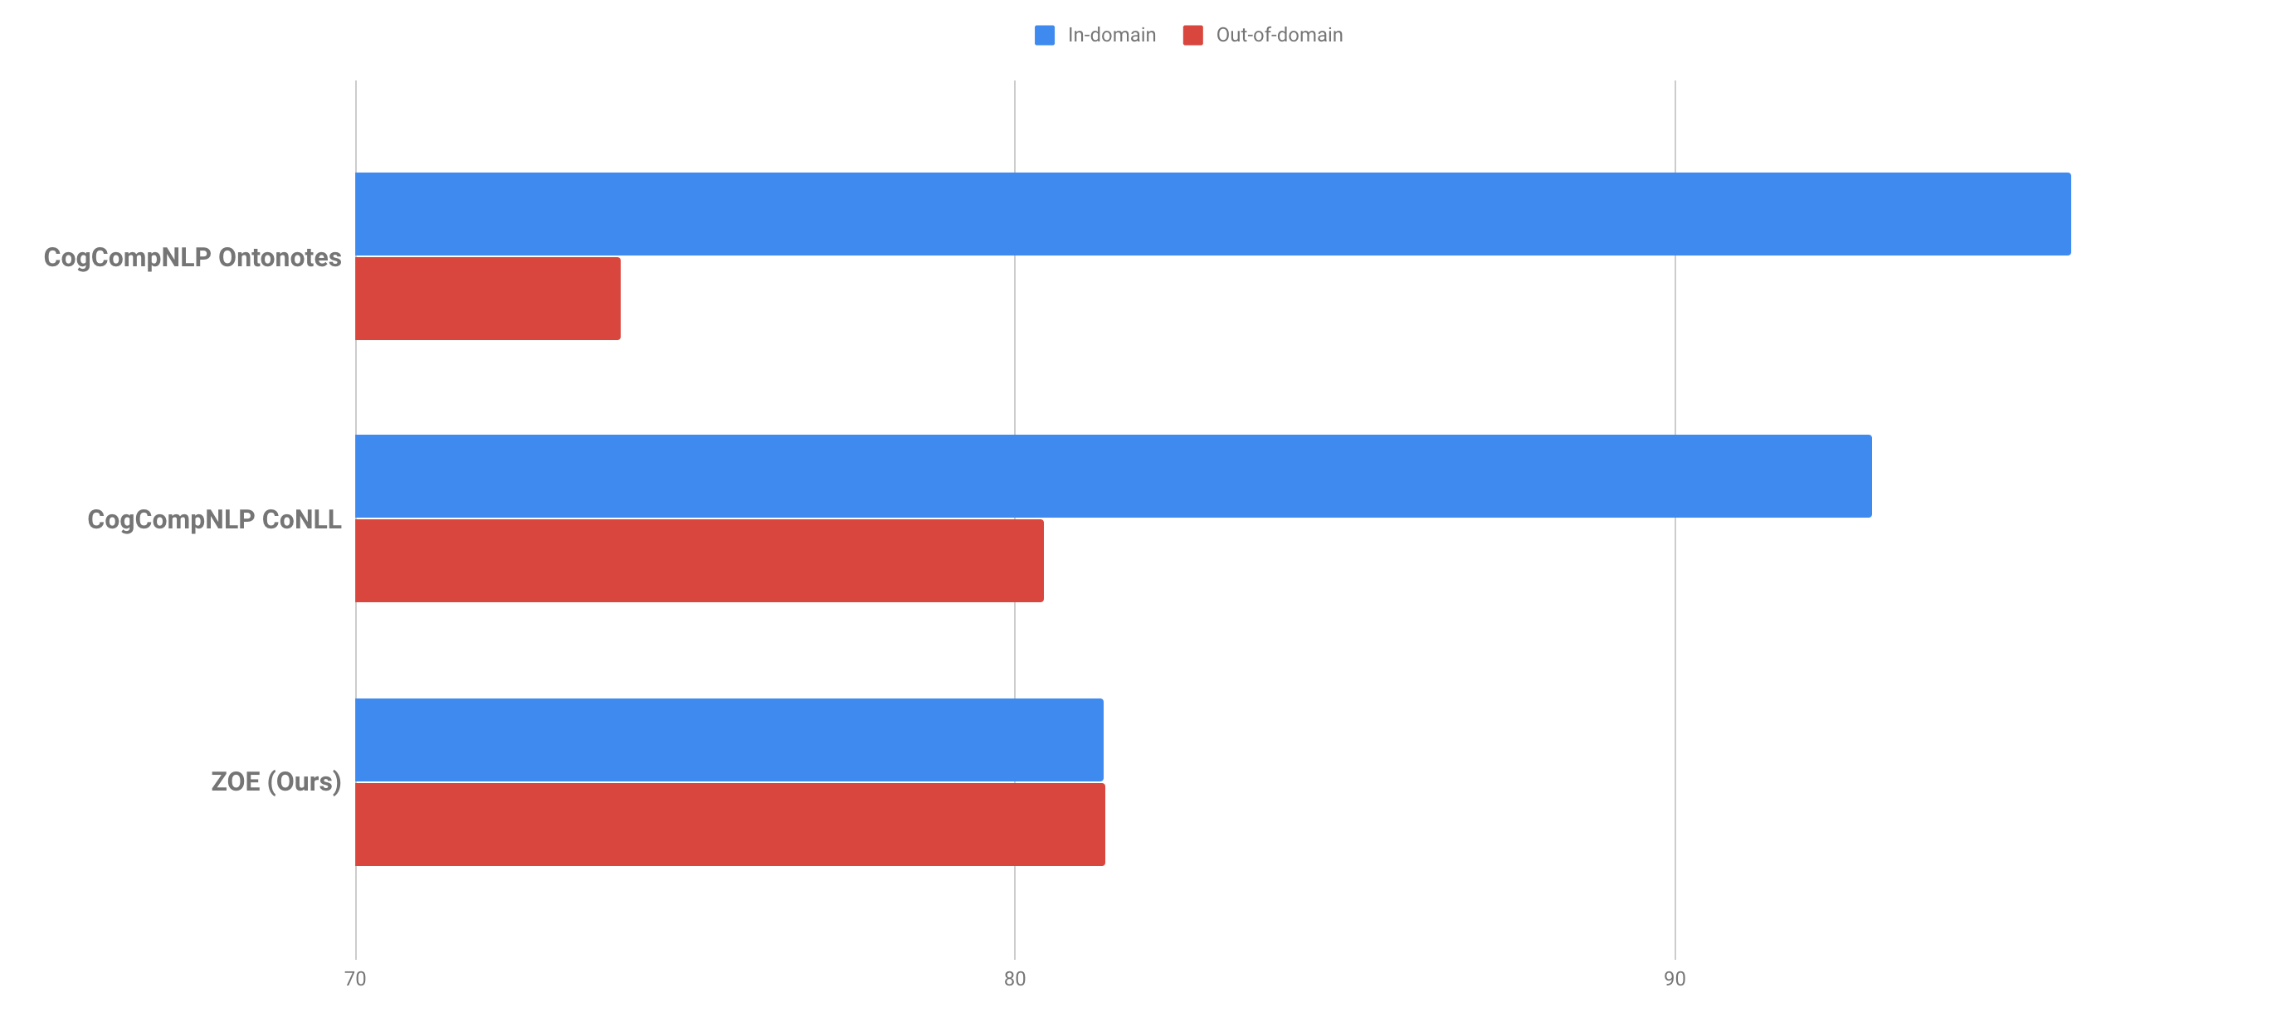
Zero-Shot Open Entity Typing as
Type-Compatible Grounding
Ben Zhou¹, Daniel Khashabi², Chen-Tse Tsai³, Dan Roth²
¹University of Illinois, Urbana-Champaign, ²University of Pennsylvania, ³Bloomberg LP
1.Goal
Given mention in its context, assign a set of types that the mention belongs to.
In this work, we extend this goal to type with an open type set, without reliance on task specific supervision (zero-shot).
Figure 1: Example inputs, corresponding compatible entities and output
2.Motivation
Most previous works focus on using supervision for typing, which often rely on costly annotation, do not generalize to unseen types or out-of-domain data.
Unlike previous systems, we propose an approach that is both open and zero-shot.
Open: Not limited to a fixed label set
Zero-shot: No need for typing-specific annotation
To achieve zero-shot, we equip our model with understanding of the labels. We propose the notion of type-compatible, which transforms the typing problem to approximating type-compatibility, by mapping an input mention to a set of type-compatible entities, then inferring their types.
Understanding: Each type is implicitly defined by entities that share that type.
Type-compatible: Two mentions are type-compatible if they share at least one type.
4.Details
We use ESA to generate a relatively large set of initial concepts.
Then we use ELMo representations to approximate context-consistency between a mention and a concept. A concept’s representation is the averaged representations of its mentions in WikiLinks.
We take a small set of concepts with top context-consistency, then use Priors to add highly confident concepts based on surface form (if any) to this set.
Then we map the concepts in the small set to target taxonomy using FreeBase as a proxy (see figure 2), by defining each target type in terms of logical expressions of FreeBase types.
The final process is a voting based Inference over types in target taxonomy.
🅐 WikiLinks: A dataset containing contextual examples for Wikipedia concepts.
🅑 ESA: Generated by treating each WikiLinks sentence as a document. It enables quick retrieval of topically relevant concepts given a sentence.
🅒 ELMo: A SOTA contextualized representation, which generates a representation for word in its context.
🅓 Priors: P(concept|surface) table, generated from Wikipedia text and anchor links.
🅔 FreeBase: A large taxonomy that each Wikipedia concept has a mapping to.
🅕 Inference: An algorithm that infers the types of the input mention, by taking into account the agreement among the types of the contextually similar concepts.
3.Model
In order to compute type-compatibility between mention and entities, we propose a notion called context-consistency.
Context-consistency: two mentions are context-consistent if they are interchangeable in some context. In other words, it represents the contextual similarity between two mentions.
We approximate the type-compatibility between a mention and an entity (represented by its mentions) through computing context-consistency.
A significant advantage of using context-consistency is that it relies mostly on context, which overcomes the issue of polysemy or rare mention surface forms. (see Figure 1)
🅐
🅒
🅔
🅑
🅓
🅕
Figure 2: Overview of the system through an example
5.Experiments
Significantly outperforms SOTA open typing system and baselines:
Comparable results with supervised systems on fine typing:
Outperforms supervised system in cross-domain settings
Note: In/Out domain does not apply to ZOE
Acknowledgements
This work was supported by the US Defense Advanced Research Projects Agency (DARPA), Google and the Allen Institute for Artificial Intelligence.
CogCompNLP
Ontonotes
CogCompNLP
CoNLL
ZOE
(Ours)
(more experiments in the paper)

